Slide 1
Virtual and Augmented Reality in Mobile Gaming using Android and Google Cardboard
Shakeel Osmani, Megan Smith

Slide 2
Project Definition
Create a virtual reality game to be used with the Google Cardboard on an Android mobile device
Create an augmented reality application on an Android mobile device to track an image and display a 3D model with respect to the marker image

Slide 3


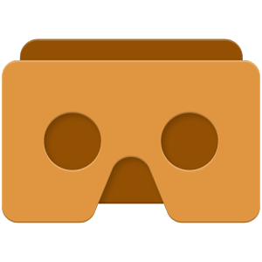


Tools Used

Slide 4
Google Cardboard
45 mm focal length lenses
The magnet is used for clicking inside of games
When you pull and release the ring, your phone’s magnetometer detects changes in the magnetic field
Utilizes compass sensor in the phone
NFC (near field communication) tag is used to trigger the launch of the Cardboard Android Application automatically
Cardboard application splits the smartphone display image into two, one for each eye
Applies barrel distortion to each image to counter pincushion distortion (towards the center of the image) from the lenses
Apparent effect is that of an image which has been mapped around a sphere or barrel
Results is a stereoscopic ("3D") image with a wide field of view

Slide 5
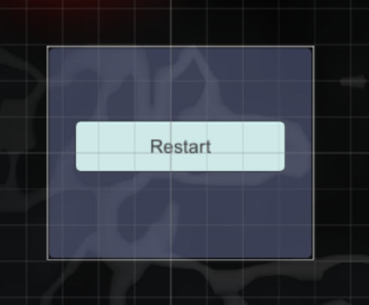
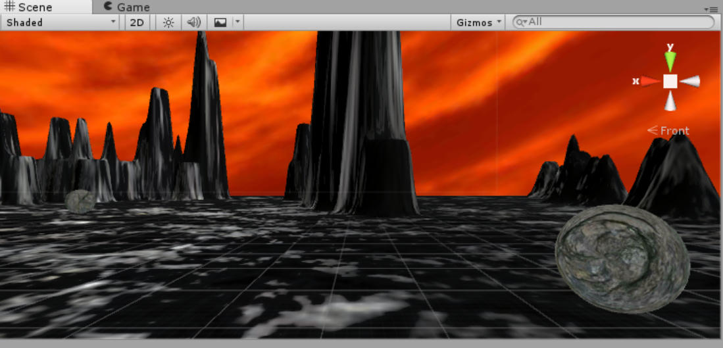
Virtual Reality with Google Cardboard
Game Objects
Monster
4 Boulders
Sky
Terrain
Camera
Point light
Canvas
Overlay
Floor

Slide 6
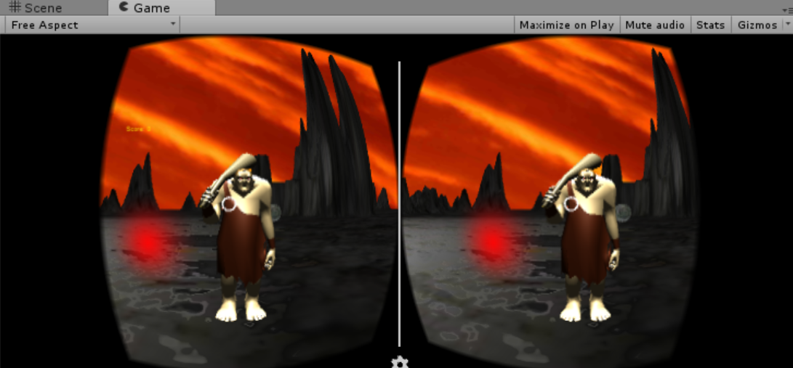
Game Story and Rules
Game is set on monsters world
He is angry
He cursed boulders to surround you
You must defeat him
Game Rules
Hit monster for 300 points
Hit moving boulders for 100 points each
Hit the monster 4 times and you win

Slide 7
Game Functions
The monster will teleport to a different location every time you hit it
An attack noise will be heard every time you hit the monster
Monster emits red particle stream to help indicate new position
The boulders move in a fixed circle and can be blown up for extra points
An explosion sound will be heard every time you destroy a boulder
Score will be displayed throughout the game
You can reset the game by looking down and hitting the ‘Reset’ button

Slide 8

Audio
Cardboard Audio Source attached to game objects
Monster roar played on a loop from awake
Audio clip is played on Pointer Click event when attacking
Monster Roar
Punch
Explosion

Slide 9
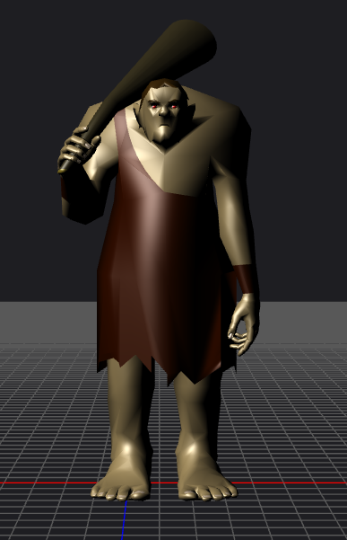
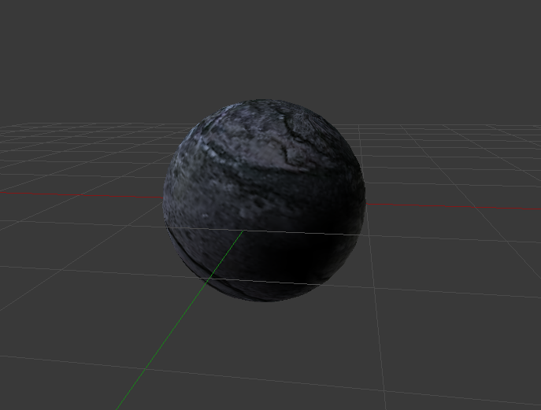
Blender Models

Slide 10
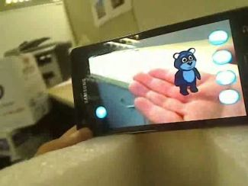
Augmented Reality with Android
what is Augmented reality
a technology that superimposes a computer-generated image on a user's view of the real world, thus providing a composite view - Google dictionary
The user’s real surrounding is augmented by extra superimposing content like CGI, Audio, Video etc.

Slide 11
Vuforia SDK
what is it?
Vuforia is an Augmented Reality Software Development Kit (SDK) for mobile devices that enables the creation of Augmented Reality applications - Wikipedia
It uses Computer Vision technology to recognize and track planar images (Image Targets) and simple 3D objects, such as boxes, in real-time
The Vuforia SDK supports a variety of 2D and 3D target types including ‘markerless’ Image Targets, 3D Multi-Target configurations

Slide 12
Hands on steps
How to build it?
For building on Android get Android SDK
Setup unity to use Android SDK
Go to Vuforia developer portal
Generate an application and an API license for the same
Process the Image target within the Vuforia database target, wait a few minutes to see if the target quality is good there is a star marker for the same
The image target is what makes tracking easier

Slide 13

Questions?

